Slide 1

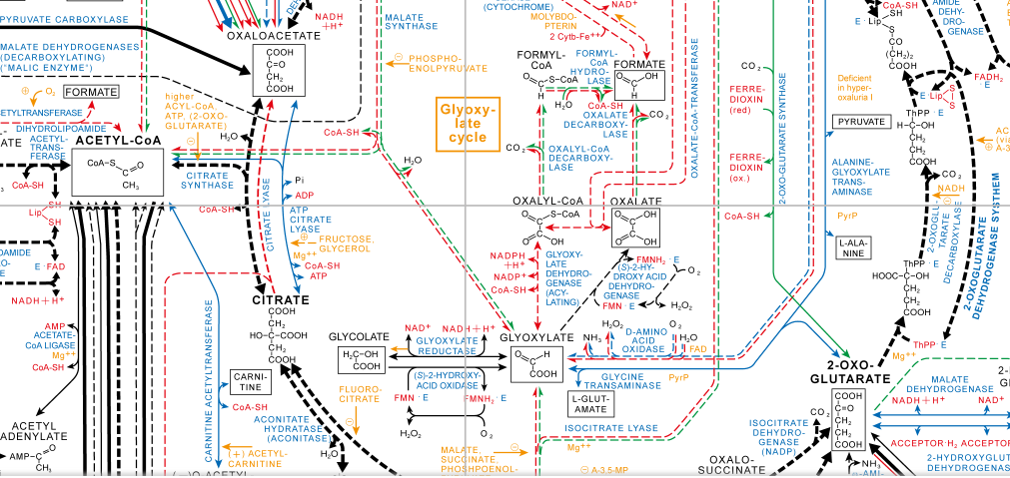
The metabolic flux analysis and energy production comparison between Actinobacillus succinogenes and Basfia succiniciproducens
RM, Swart
Department of Chemical Engineering
University of Pretoria

Slide 2
Technical background
Actinobacillus succinogenes:
wild-strain, succinic acid producer, high yields
Basfia succiniciproducens:
wild-strain, limited literature, TCA cycle
Spent sulphite liquor:
liquid waste stream, acidic sulphite wood pulping process, C5 and C6 sugars
Xylose:
predominant sugar in SSL, simplifies analysis through modeling

Slide 3
Problem statement
Motivation:
gain more insight into the research through mass and energy analysis
Hypothesis:
a full TCA in Basfia enabled higher succinic acid titres

Slide 4
Aim & Objectives
Modelling:
mass balance check, metabolic pathways, energy analysis
Hypothesis:
compare metabolic mechanisms, determine validity

Slide 5

Mass balances
Equations:
$Xylose+CO2+NH3→X+Succinic acid+Acetic acid+Formic acid+Water$
$Xylose+CO2+NH3→X+Succinic acid+Acetic acid+Formic acid+Lactic acid$
$Succi: CH1.896O0.603N0.258$
Basfia$: CH1.8O0.5N0.2$

Slide 6
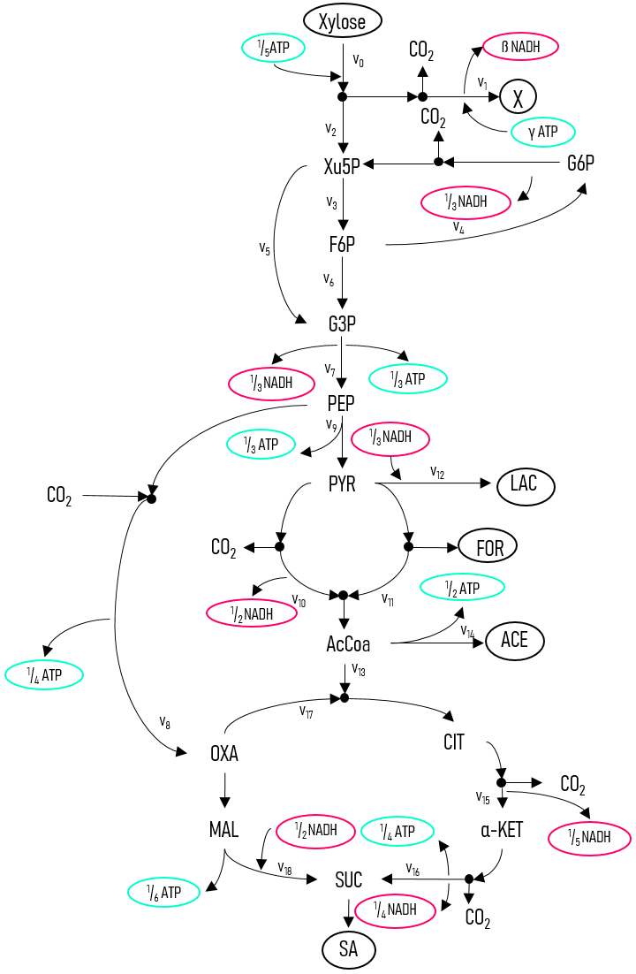
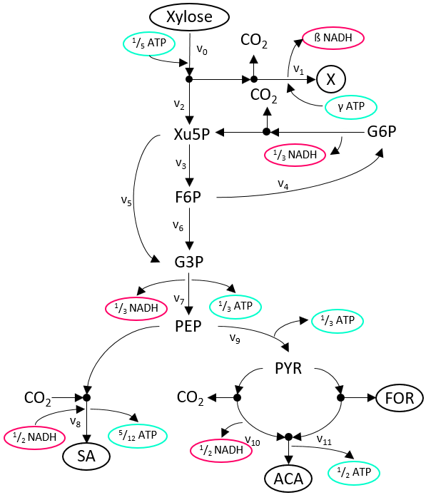
Modelling
Metabolic pathways:
Pentose phosphate
Anaerobic fermentation
Glycolysis
TCA cycle
Product differences
Rates determined from concentration profiles

Slide 7
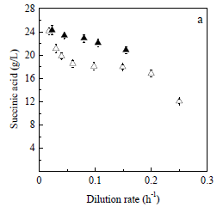
Paper analysis
Succinic acid production:
Xylose fermentation
Basfia (▲), Succi (△)
Highest production rate at 0.04 1/h

Slide 8
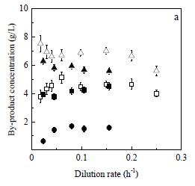
Paper analysis
By-product production:
Acetic acid (▲,△), formic acid (■,□) and lactic acid (●)
By-product concentrations decrease for Succi however with Basfia they seem to increase.

Slide 9
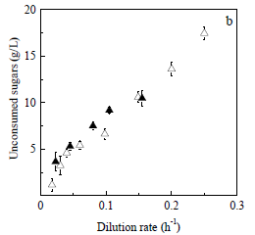
Paper analysis
Xylose consumption rate:
Initial xylose concentration of 40 g/l
Consumption of xylose decreases as the dilution rate increases.
However more analysis is required (rate).

Slide 10
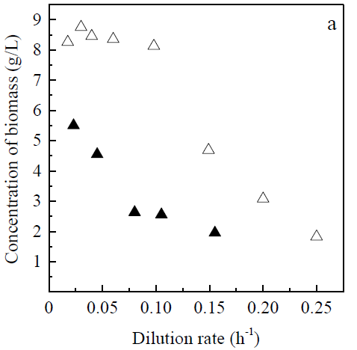
Paper analysis
Biomass growth:
Basfia has a noticeably lower biomass concentration.
More carbon can be directed to catabolites
The values were determine through the use of a metabolic model.

Slide 11
Results & Discussion
Overall:
The data from the previously shown figures was extracted.
All the analysis was conducted using the Python coding language in the Jupyter notebook environment.
The report was also written in this environment which allowed to run the code within the report as well as easily link to the code.

Slide 12
Mass balance
Succi:
Succi error = 12,31%
Carbon sink, pyruvate or CO₂ consumption.
Biomass calculated (g/l) | Biomass (g/l) Ladakis, et al. (2018)
8.043652 | 8.268500
8.972723 | 8.757975
9.074009 | 8.439278
9.027901 | 8.346848
8.414268 | 8.105461
4.680004 | 4.689667
3.060670 | 3.096459
4.727327 | 1.822547

Slide 13
Mass balance
Basfia:
Basfia error = 11,85%
Consistently less biomass, CO₂ consumption.
Biomass calculated (g/l) | Biomass (g/l) Ladakis, et al. (2018)
5.177417 | 5.488145
4.370697 | 4.531535
2.517662 | 2.636464
2.049101 | 2.563182
1.821668 | 1.965719

Slide 14
Results & Discussion
Metabolic analysis:
Rate matrix: nodal balances, NADH balance, stoichiometric and rate specifications.
Rates were calculated from the mass balance.
Through the a CO₂ comparison between the mass balance and flux model it was determined that they solved for the same solution.

Slide 15
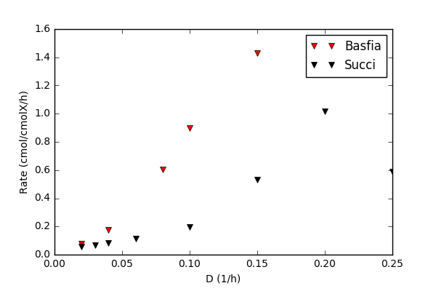
Metabolic flux analysis
Succinic acid production:
Basfia has high rate of succinic production.
Expected: lower biomass and higher production concentration.
The full TCA cycle may be a cause.

Slide 16
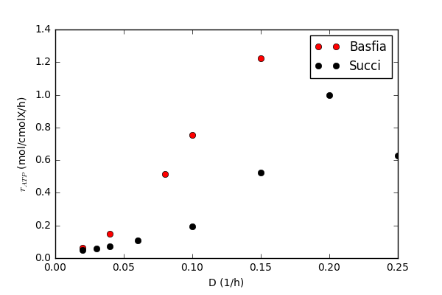
Metabolic flux analysis
ATP production:
ATP balance was not used in the flux matrix.
Basfia clearly out produces Succi.
Able to pump out more succinate.

Slide 17

Metabolic flux analysis
Enzyme activity:
Phosphoenolpyruvate carboxylase enzyme is present in both Succi and Basfia.
PEP to OXA
This enzyme is far more active in Basfia.
Explains ATP and succinic rates.

Slide 18
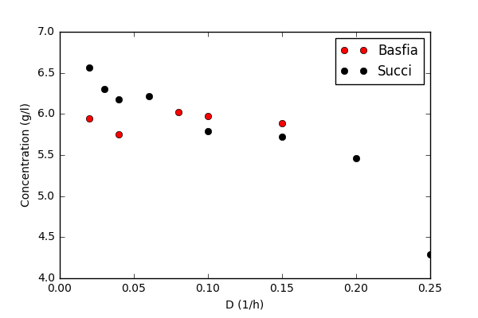
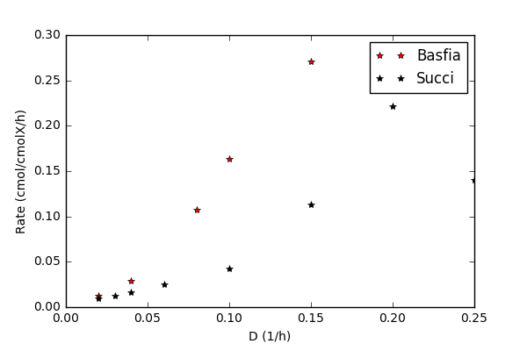
Metabolic flux analysis
CO₂ consumption:
constant CO2 consumption which leads to higher rates.

Slide 19
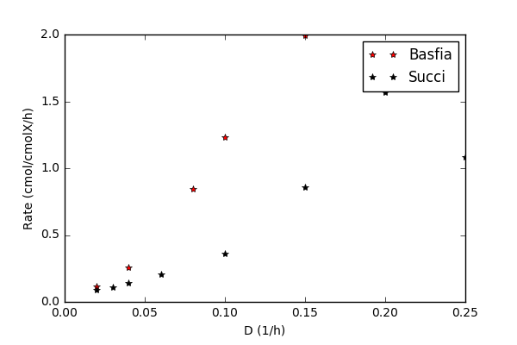
Metabolic flux analysis
Xylose consumption:
At some points Basfia’s xylose consumption is more than double that of Succi.
This combined with the higher CO₂ rates explains how Basfia is able is able to produce higher rates.

Slide 20
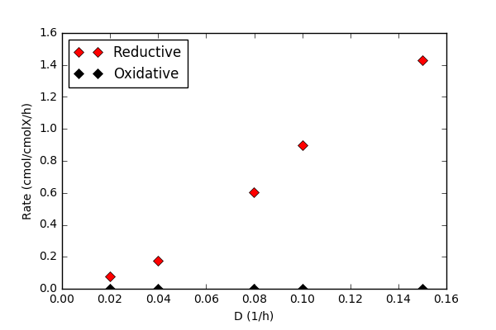
Metabolic flux analysis
TCA analysis:
Basfia uses the reductive and oxidative branch of the TCA cycle to produce succinate.
However, it seems to have optimised it metabolism by shutting down the oxidative branch.

Slide 21
Conclusion
Succinic acid:
Basfia is able to produce at far higher rates.
Phosphoenolpyruvate carboxylase enzyme :
This enzyme is more active in Basfia, contributes to ATP production, CO₂ rate.
TCA cycle
In Basfia all carbon is then channelled through the reductive pathways.

Slide 22
Thank you. Questions?

